Slide 1

MGMT 68700 Final Project
Airbnb Revenue Forecast and Influencing Factors Analysis
Team Information:
Huangkun Chen
Yingtong Wang

Slide 2
SUMMARY
01
02
Research Objectives
Main Findings
Identify and quantify the key drivers of Airbnb listing revenue
In-depth analysis of regional differences in housing income in the Washington area
Build a predictive model to assess the impact of factors on listing revenue
Provide data-based revenue optimization recommendations to landlords
Listing pricing strategy is the most critical factor affecting revenue, including the reasonable setting of nightly prices and cleaning fees, which have a significant impact on revenue.
The review system of a property has an important impact on income. High-quality reviews and a sufficient number of reviews can bring better income performance.
There is a significant positive correlation between a host's service level (including response rate and super host status) and income.
The location of a property is an important determinant of income differences, with significant differences in income levels between communities
The basic attributes of a property (such as the number of bedrooms, maximum occupancy) have a secondary impact on income than the service quality and evaluation system

Slide 3
Business Problem Description
How to set the best price in a competitive market
The amatching degree between house pricing and regional market
The reasonable setting of additional fees such as cleaning fees
Room for improving room booking rate
Management of income fluctuations during off-season and peak-season
Demand for optimizing booking cycle
The impact of the user evaluation system on income
Quantitative indicators of landlord service level
Value assessment of super landlord certification
Reasons for income differences between different communities
Matching degree between housing characteristics and target customer groups
Assessment of regional market competitiveness
01
02
03
04
Pricing challenges
Operational efficiency
Service quality
Market positioning

Slide 4
Data Overview
Data Structure
Source: Airbnb Washington Public Dataset
Time Range: 2016-2018
Geographic Coverage: Washington, DC and surrounding areas
Sample Size: 133,741 records
Category | Description
Total Features | 111 variables
Numeric Variables | 102 (float64: 96, int64: 6)
Categorical Variables | 8
Boolean Variables | 1
Key Variable Categories
Variable Type | Representative Indicators | Count
Price Related | Nightly Rate, Cleaning Fee, Revenue | 15
Property Features | Bedrooms, Property Type, Max Guests | 12
Location Info | Neighborhood, Zipcode, Coordinates | 8
Rating Metrics | Overall Rating, Review Count, Five-star Reviews | 18
Host Attributes | Response Rate, Superhost Status | 10
Booking Data | Reserved Days, Available Days | 14

Slide 5
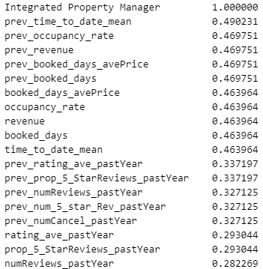
Data Processing and Feature Engineering
Missing Value Treatment
Removed features with missing rate higher than 40% to ensure data quality
Applied linear interpolation for time series data including ratings and reviews
Used neighborhood-based median imputation for availability and pricing data
Filled categorical variables with mode values by neighborhood groups
Applied median imputation for remaining numeric variables
Feature Engineering
Created price fluctuation indicator by comparing nightly rate with average listed price
Developd host response score combining response rate and instant booking status
Generated seasonal occupancy ratio from reserved days and available days
Added price quartile features for neighborhood comparison
Combined superhost status with review metrics for service quality measurement

Slide 6
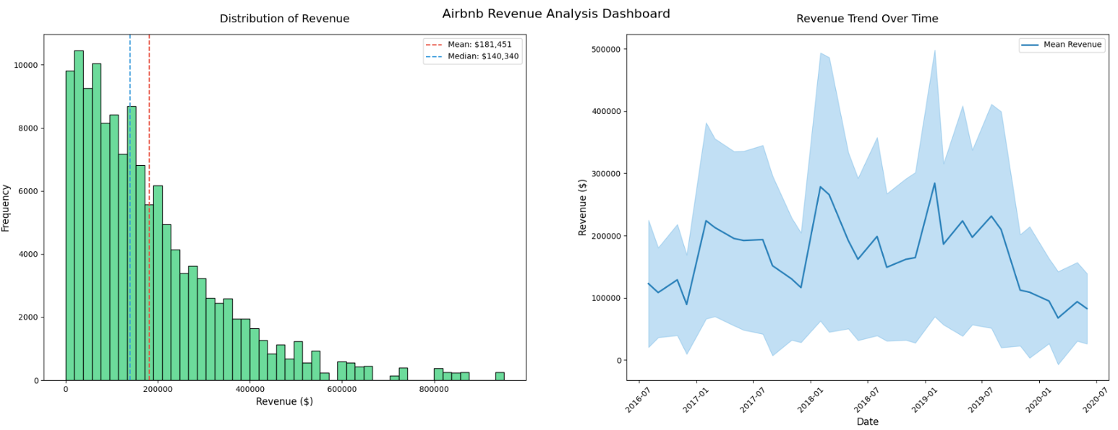
Airbnb Revenue Analysis

Slide 7
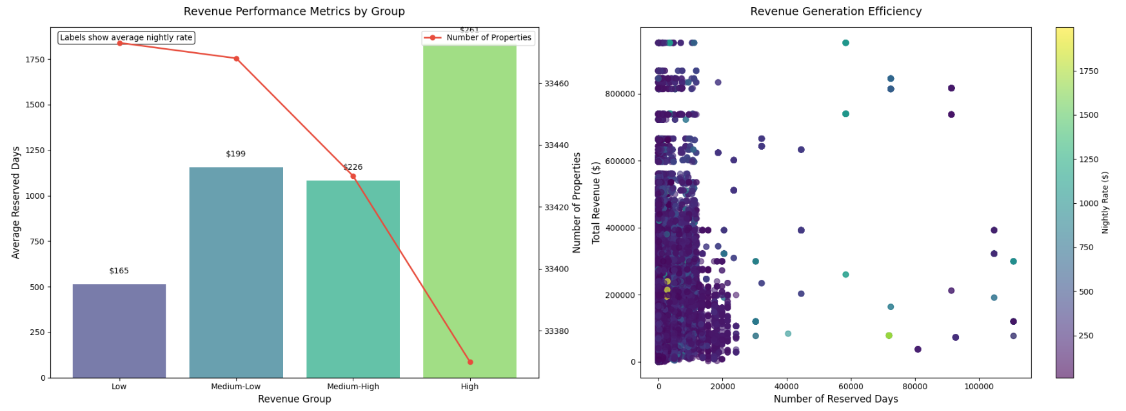
VISUAL ANALYSIS

Slide 8
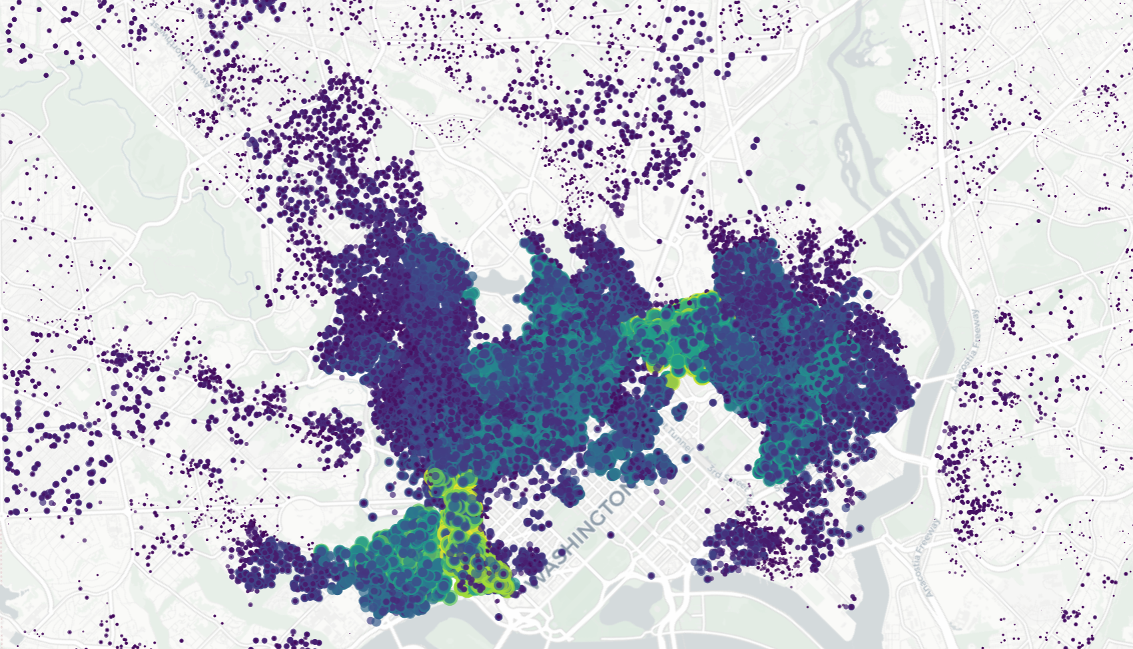
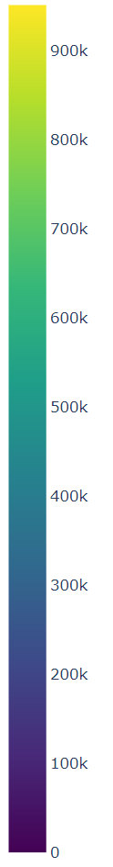
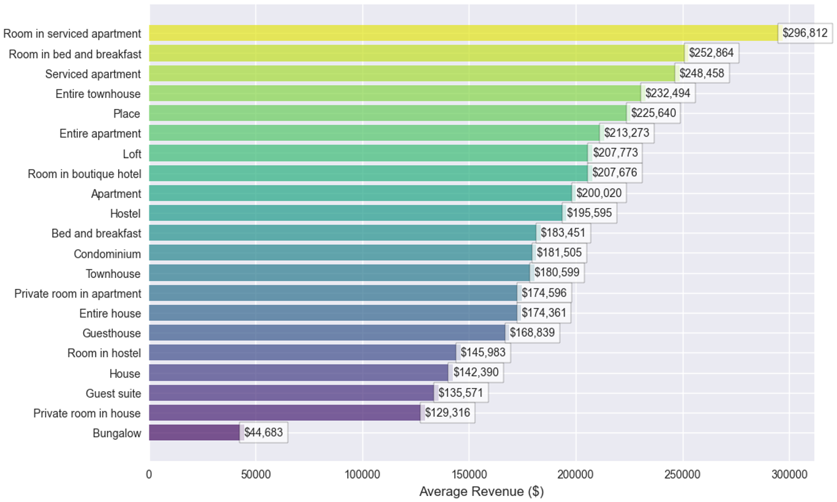
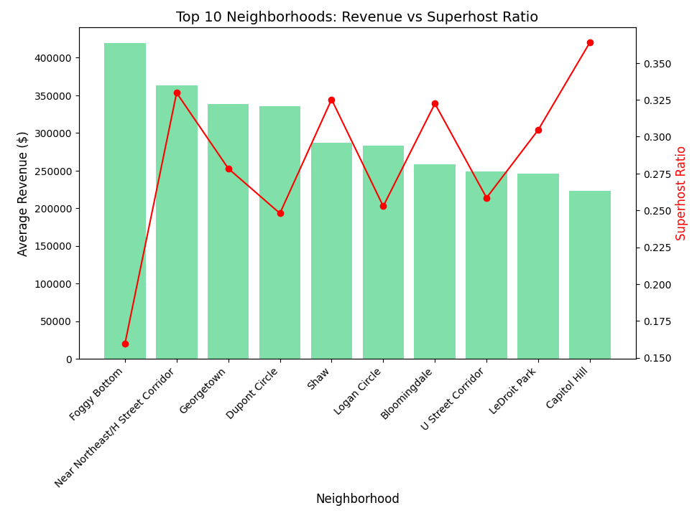
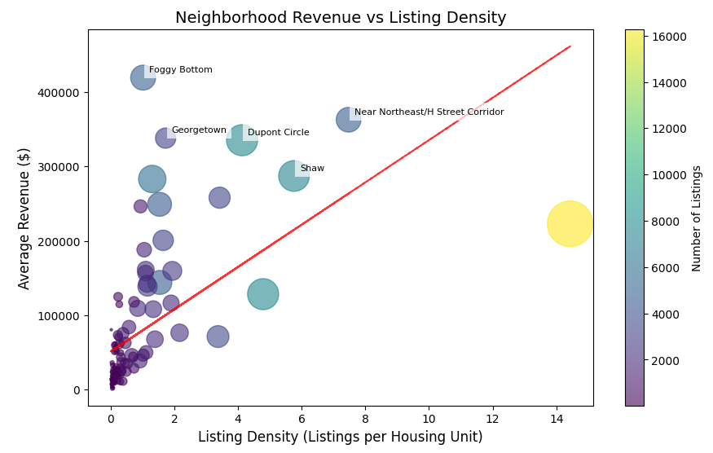
VISUAL ANALYSIS

Slide 9
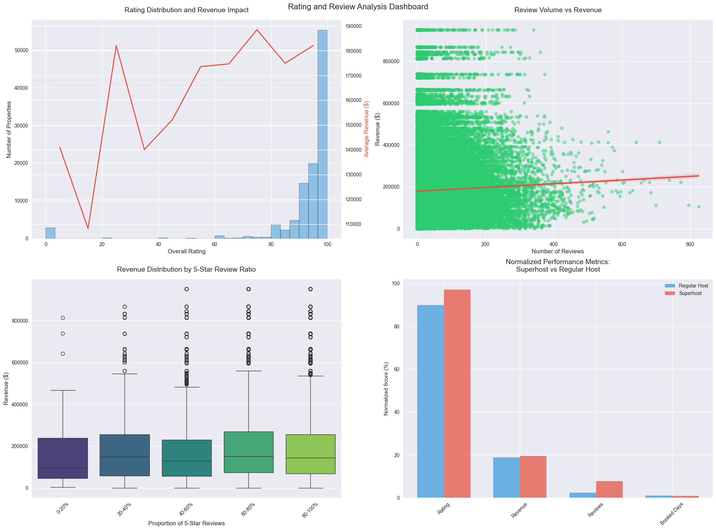
VISUAL ANALYSIS

Slide 10
Model Building
Model Selection
Parameters Configuration
Selected Random Forest Regressor as primary model
Ability to handle non-linear relationships
Feature importance insights
Strong performance with mixed data types
Number of trees: 200
No maximum depth constraint
Minimum samples split: 5
Minimum samples leaf: 2
Training Process
Model Performance
Split ratio: 80% training, 20% testing
Applied 5-fold cross validation
Used standardized features
Maintained original target scale for interpretation
Implemented early stopping to prevent overfitting
Testing Set Performance:
R² Score: 0.9942
Mean Squared Error: 0.0058
Root Mean Squared Error: 0.0765
Mean Absolute Error: 0.0215

Slide 11
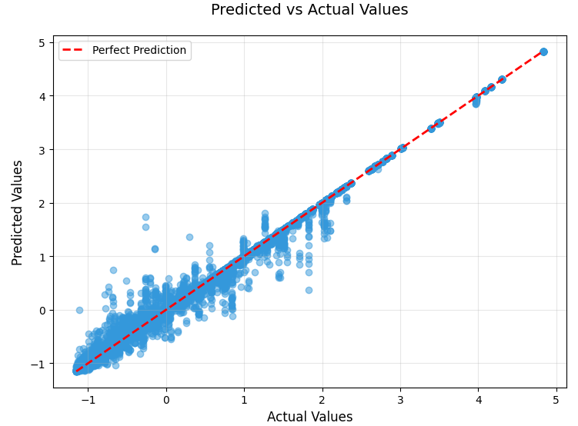
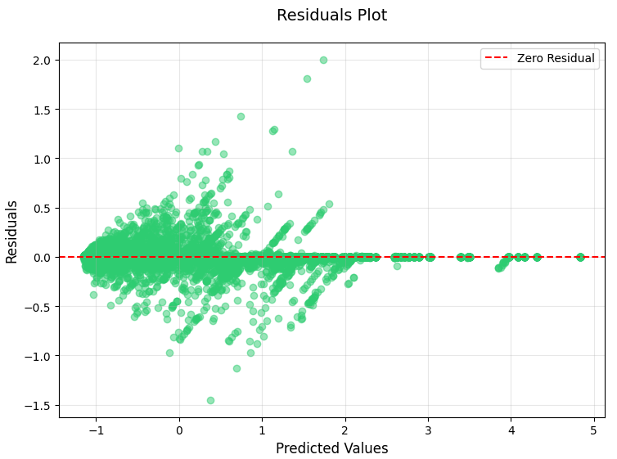
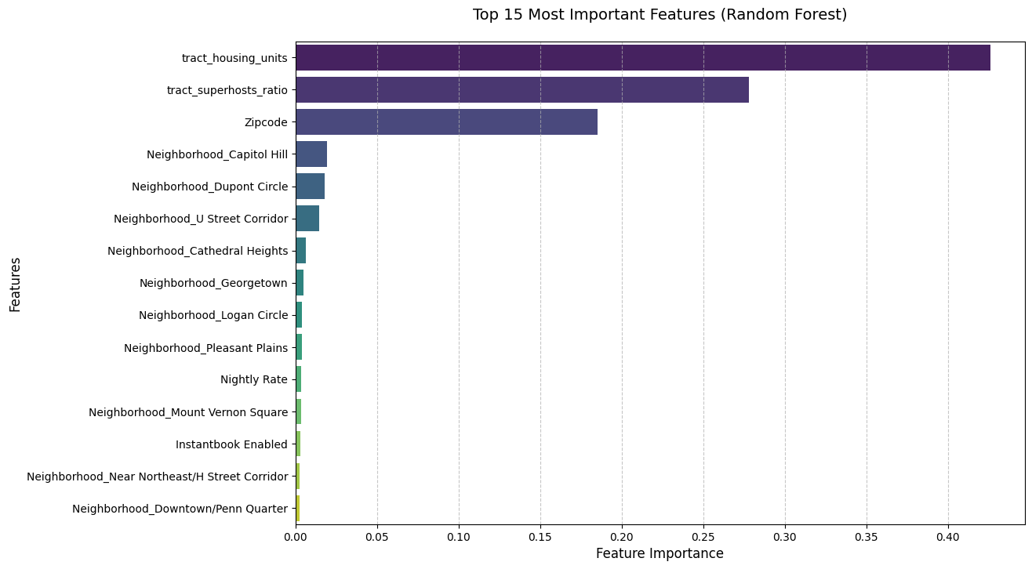
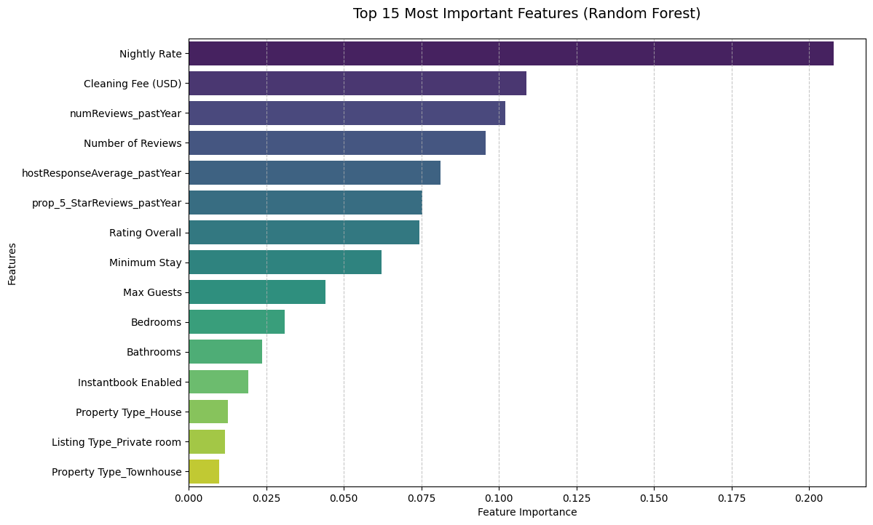
Results Analysis

Slide 12
Impact Analysis and Recommendations
Market Trend Analysis
Platform Strategic Direction
Regional differentiation is obvious, and the gap between core areas and emerging areas is widening
Service quality is improved overall, and professional landlords dominate the market
User demand is upgraded, and the transition from simple accommodation to quality experience is made
Use machine learning to optimize recommendation systems and dynamic pricing tools
Strengthen the landlord empowerment system, provide business analysis and training support
Improve the super landlord mechanism and establish service quality standards
Landlord Business Strategy
Model Performance
Select target areas based on data to avoid excessive competition
Dynamically adjust pricing strategies to balance revenue and occupancy rate
Improve service quality and maintain high response and praise rate
The market is concentrated on professional landlords, and management is more standardized
The focus of competition has shifted from price to comprehensive service capabilities
Regional characteristic competition has intensified, and differentiated positioning has become more important

Slide 13
References
Wang, D., & Nicolau, J. (2017). Price determinants of sharing economy based accommodation rental : a study of listings from 33 cities on Airbnb.com. International Journal of Hospitality Management, 62, 120-131. https://doi.org/10.1016/J.IJHM.2016.12.007.
Magno, F., Cassia, F., & Ugolini, M. (2018). Accommodation prices on Airbnb: effects of host experience and market demand. The TQM Journal. https://doi.org/10.1108/TQM-12-2017-0164.
Peng, Y. (2019). Pricing Analytics of the Sharing Economy in Lodging—A Case Study of the Airbnb Online Marketplace. Proceedings of the 2019 International Conference on Economic Management and Cultural Industry (ICEMCI 2019). https://doi.org/10.2991/aebmr.k.191217.145.
Ye, P., Qian, J., Chen, J., Wu, C., Zhou, Y., De Mars, S., Yang, F., & Zhang, L. (2018). Customized Regression Model for Airbnb Dynamic Pricing. Proceedings of the 24th ACM SIGKDD International Conference on Knowledge Discovery & Data Mining. https://doi.org/10.1145/3219819.3219830.

Slide 14

THANKS FOR listening！

Slide 15
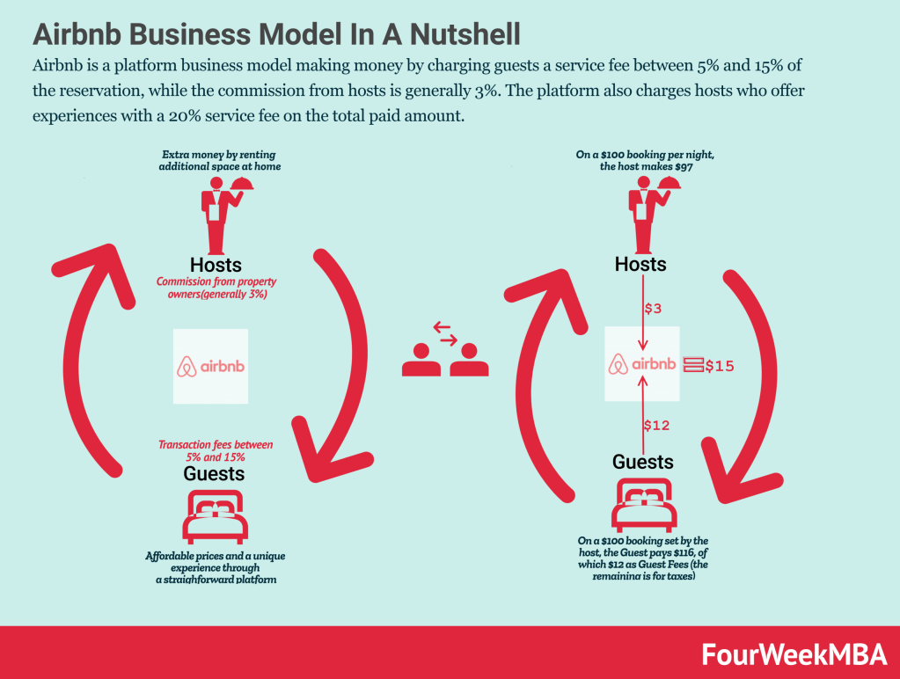
Airbnb Background
Airbnb is a platform business model that makes money by charging guests a service fee of 5% to 15% of the booking fee, while hosts generally receive a commission of 3%. For example, on a $100 nightly booking set by a host, Airbnb may earn up to $15, paid by the host and the guest.
As a peer-to-peer platform, once a transaction between a host and a guest is completed, Airbnb will charge fees to both parties as the main participants. For example, on a $100 nightly booking set by a host, Airbnb may charge $3 as a hosting fee. While it may raise the guest's price to $116 ($16 higher than the price set by the host) to collect $12 in guest fees and taxes on the remaining amount. In 2022, Airbnb generated $39.37 billion in gross booking value from more than 6.32 billion nights of bookings and experiences, with an average revenue of $161 per booking, revenue of $8.4, and an average service fee of 13.3%.

Slide 16
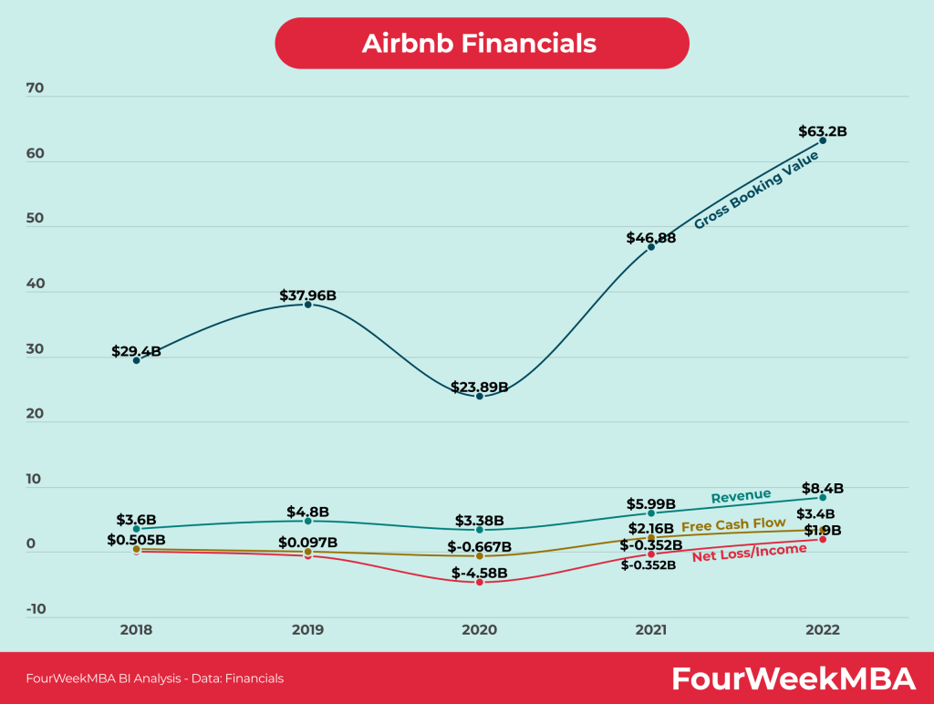
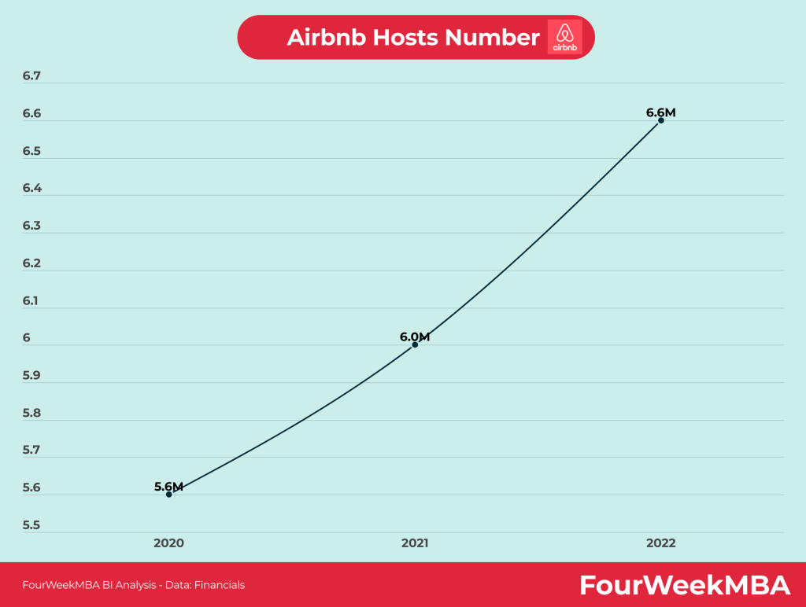
Airbnb Background
Airbnb makes money by charging a commission on every transaction on the platform. In 2022, Airbnb processed more than $6.3 billion in gross booking value, translating into $8.4 billion in revenue. Airbnb also generated $1.9 billion in profit and $3.4 billion in free cash flow in 2022.
In 2022, Airbnb had 6.6 million active listings, compared to 6 million in 2021, a 10% increase year over year.

Slide 17
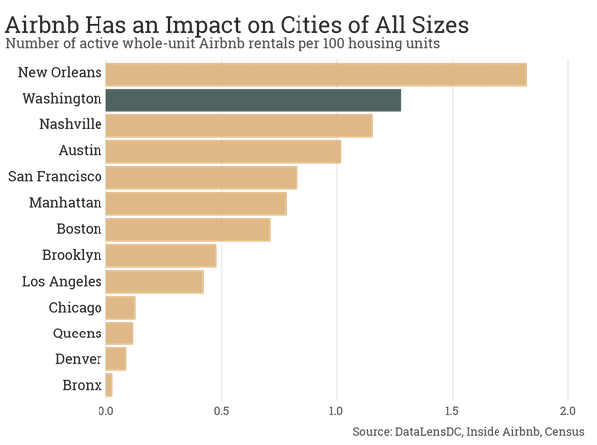
Background on Airbnb in Washington
Researchers at McGill University found that the majority (51%) of listings in New York City are entire homes or apartments, and that these entire homes (the vast majority of which appear to be illegal under New York State law) account for 75% of the city’s total Airbnb revenue. They also estimated that commercial operators make up 12% of New York City’s landlords but more than a quarter of Airbnb’s revenue. The report concluded that Airbnb rentals have removed between 7,000 and 13,500 units from the city’s long-term rental market over the past three years and raised New York’s median rent by $380.
Short-term rentals are a concern outside of New York: Cities of all sizes are feeling the impact of Airbnb (and smaller competitors like HomeAway) on their housing supply. According to data published by Inside Airbnb, an independent website that collects data on Airbnb listings, in at least four cities, active entire home rentals on Airbnb account for more than 1% of all housing units. Among cities with available data, Washington, D.C., has the second-highest number of Airbnb homes or apartments.

Slide 18
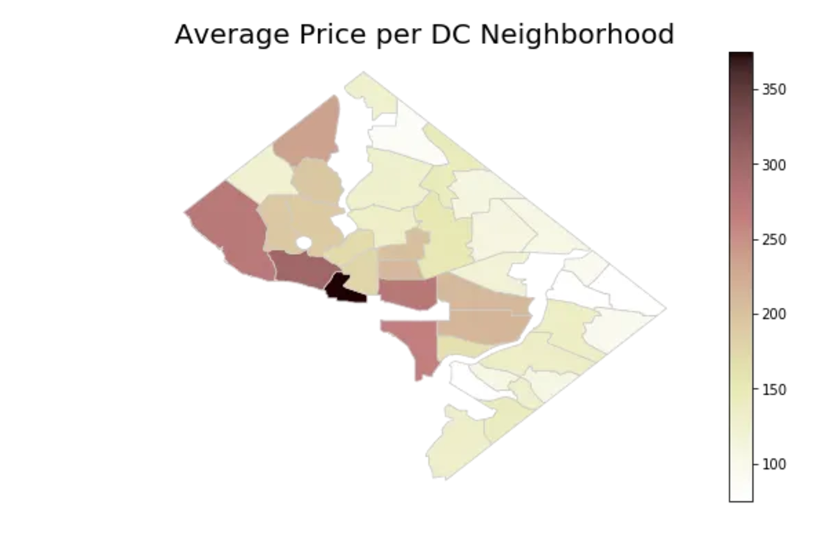
Background on Airbnb in Washington
The neighborhood with the highest average price is Foggy Bottom at $382, which is home to DC staples like the Kennedy Center, the Watergate Hotel, and George Washington University. The neighborhood is located on the northwest border of the National Mall, represented by the open white space in the map below. The neighborhood with the lowest average price, at $90, is Deanwood, which is located in the northeast quadrant of Washington, DC, and is one of the easternmost neighborhoods in the map below. Many of the homes in Deanwood were designed and built by famous African-American architects William Sidney Pittman and Howard D. Woodson. This neighborhood is also where Marvin Gaye was born and raised.

Slide 19
Airbnb Host Handbook: Key Strategies, Policies, and Tips
Ensure cleanliness and comfort
High standards of cleanliness: Make sure your space is thoroughly cleaned before each guest arrives. Consider hiring a professional cleaning service to maintain high standards.
Comfort amenities: Provide high-quality bedding, towels, and toiletries. Offer entertainment options like books, board games, and streaming services. Make sure your kitchen is stocked with necessary cooking utensils and basic pantry items.
Leverage reviews and feedback
Reviews are a powerful tool for increasing the visibility and trustworthiness of your Airbnb listing. Not only do positive reviews attract more guests, they also improve your ranking in Airbnb search results. This section will guide you on how to encourage reviews and respond to feedback effectively to improve your listing’s performance.
Encourage reviews: Politely ask guests to leave a review after their stay. Positive reviews can significantly increase your listing’s visibility and appeal to potential guests.
Listings with more than 50 reviews are booked 20% more frequently than listings with fewer reviews (Source: Airbnb).
Reply to feedback: Reply to all comments, both positive and negative. Thank guests for their positive reviews and address any concerns raised in negative reviews.
Hosts who consistently respond to reviews see 5% more bookings compared to hosts who don’t respond to reviews (Source: Airbnb).
Key benefits of accumulating more reviews
Improve visibility and ranking: Reviews can improve your Airbnb ranking, making your listing more visible and attractive to potential guests.
Increase booking rates: Listings with more reviews can see up to 15% higher conversion rates from browser to booker.
Revenue growth: Each 5-star review can increase your annual gross booking value (GBV) by up to 3.2%.
Optimize listing performance: Higher review scores increase your listing’s algorithm score, thereby increasing overall visibility on the platform.

Slide 20
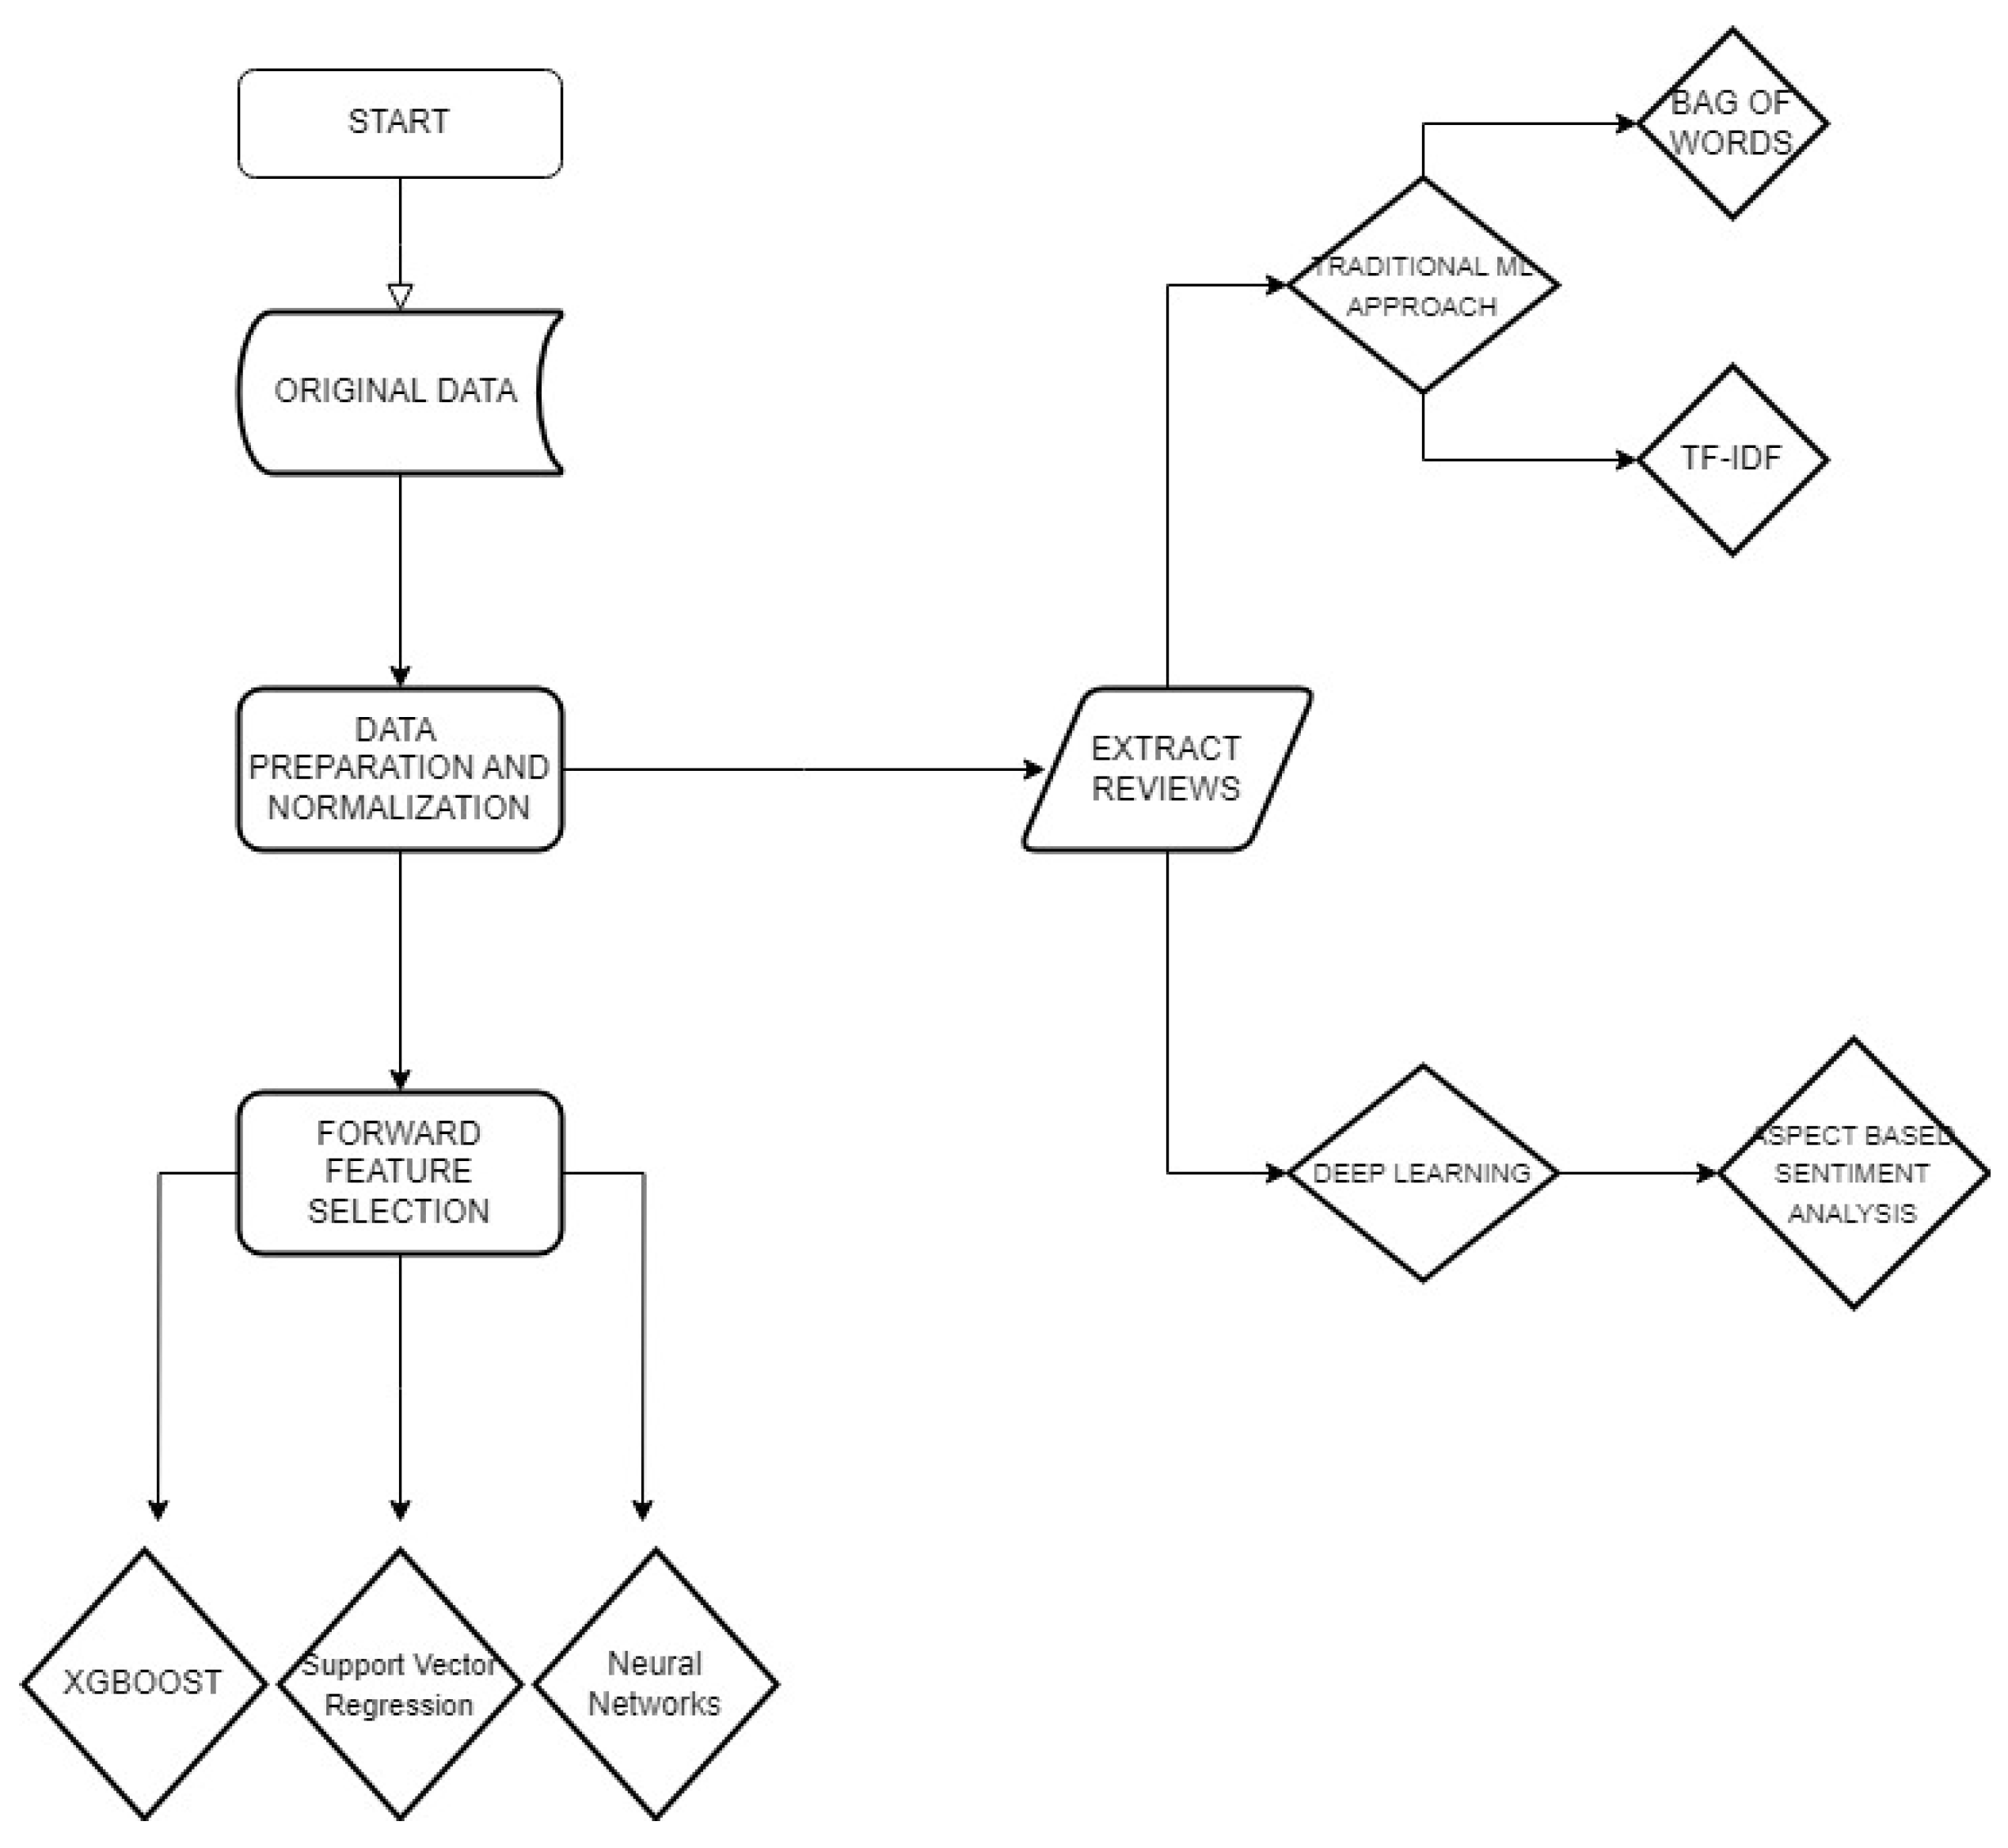
Related research
Maximizing Profitability and Occupancy: An Optimal Pricing Strategy for Airbnb Hosts Using Regression Techniques and Natural Language Processing
Luca Di Persio et al. introduce a solution that can enhance owners’ understanding of the market value of their properties in urban environments, thereby optimizing the utilization and profitability of their listings. A multifaceted approach and various models, including support vector regression, XGBoost, and neural networks, are used to analyze the impact of factors such as location, host attributes, and guest reviews on the financial performance of listings. To further refine the predictive model, they integrate natural language processing techniques for in-depth listing review analysis, focusing on term frequency-inverse document frequency (TF-IDF), bag-of-words, and aspect-based sentiment analysis.

Slide 21
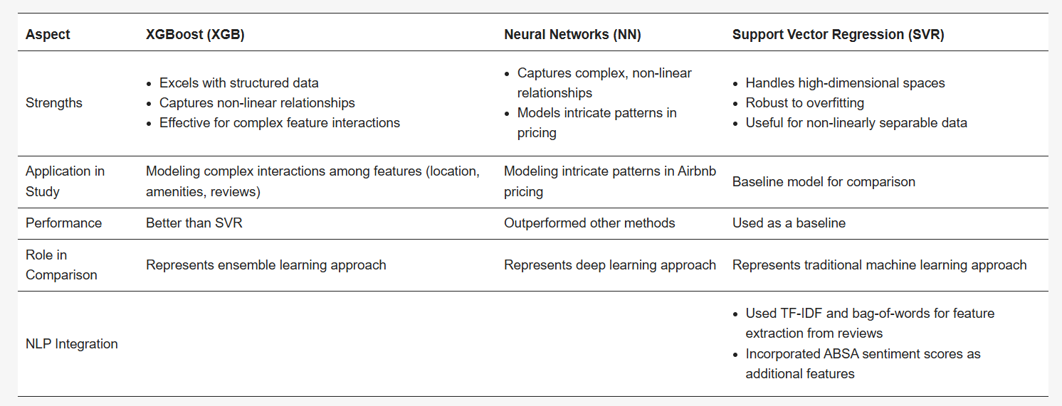
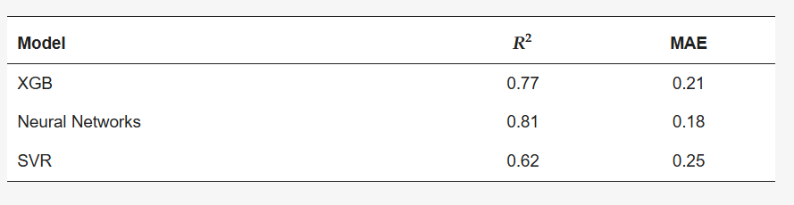
Related research
The findings suggest that Airbnb hosts can effectively leverage state-of-the-art and traditional machine learning algorithms to better understand buyers’ needs and preferences, more accurately assess the market value of listings, and focus on the importance of dynamic pricing strategies. By adopting this data-driven approach, hosts can strike a balance between maintaining competitive prices and ensuring high occupancy rates.

Slide 22
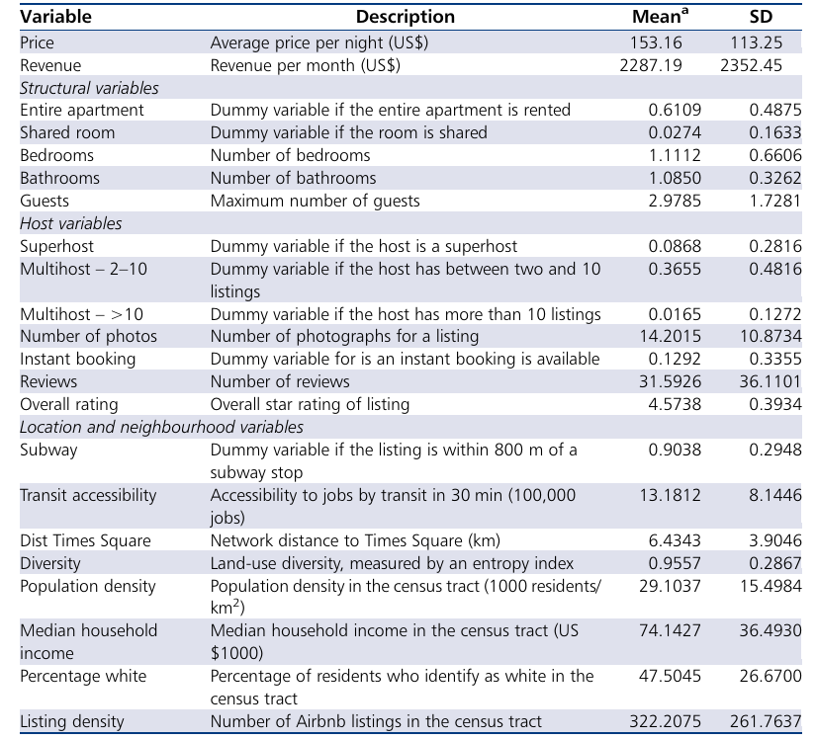
Related research
Location, location and professionalization: a multilevel hedonic analysis of Airbnb listing prices and revenue
Hedonic modeling techniques are frequently used to examine real estate valuations and have recently been applied to short-term rental valuations. Relying on a web-scraped dataset of all Airbnb transactions in New York City (NYC) between August 2014 and September 2016, this paper presents the first hedonic regression model for Airbnb that accounts for neighborhood effects and predicts both the average nightly price, and the revenue generated per listing. The model shows that both location factors (especially accessibility to work) and neighborhood differences have a strong influence on both nightly price and monthly revenue and further reveals how the specialization of the short-term rental market generates more revenue for a narrower group of hosts. Furthermore, the findings suggest that Airbnb hosts earn a substantial premium by converting long-term housing in accessible neighborhoods into de facto Airbnb hotels. This premium incentivizes hosts and landlords with properties in accessible neighborhoods to replace long-term renters with short-term renters, forcing those seeking housing to move to accessible neighborhoods.

Slide 23
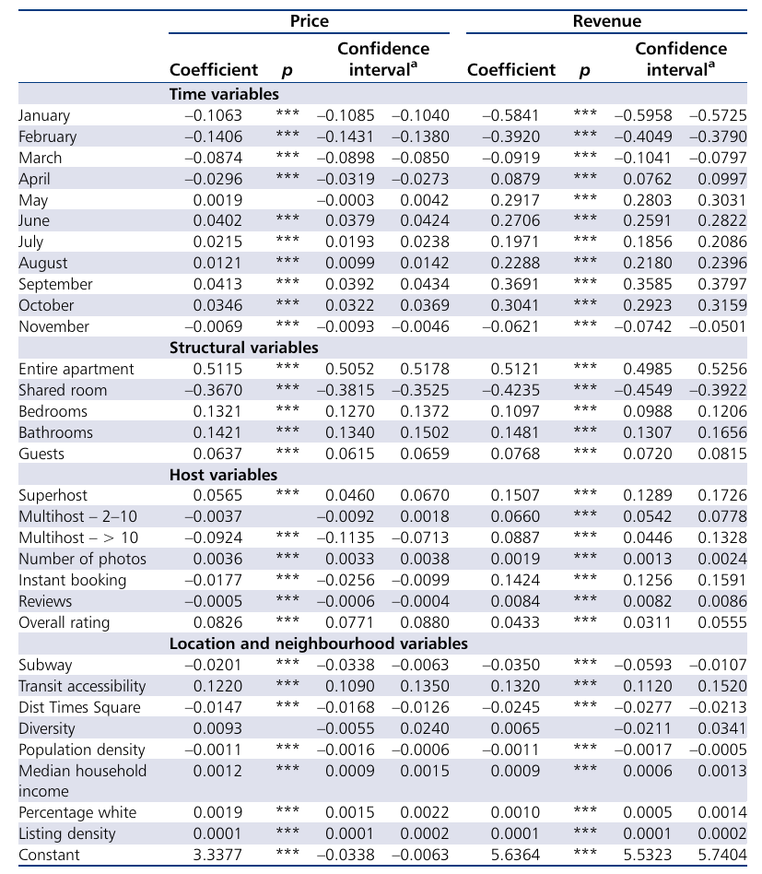
Related research
Location, location and professionalization: a multilevel hedonic analysis of Airbnb listing prices and revenue
Experimental data and results:
Location impact: Research has found that accessibility (such as distance from metro stations and city centers) has a significant impact on listing income. House prices and incomes are generally higher for properties near transportation hubs and business districts.
Impact of specialization: Landlords with a higher degree of specialization (managing multiple listings) can earn higher incomes. This group of landlords usually convert their listings into functions similar to "short-term hotels" to earn more income.
Chart: Provides a heat map of the impact on listing income based on community type and location, clearly showing the differences in the impact of different regions and landlord specialization on prices and income.

Slide 24
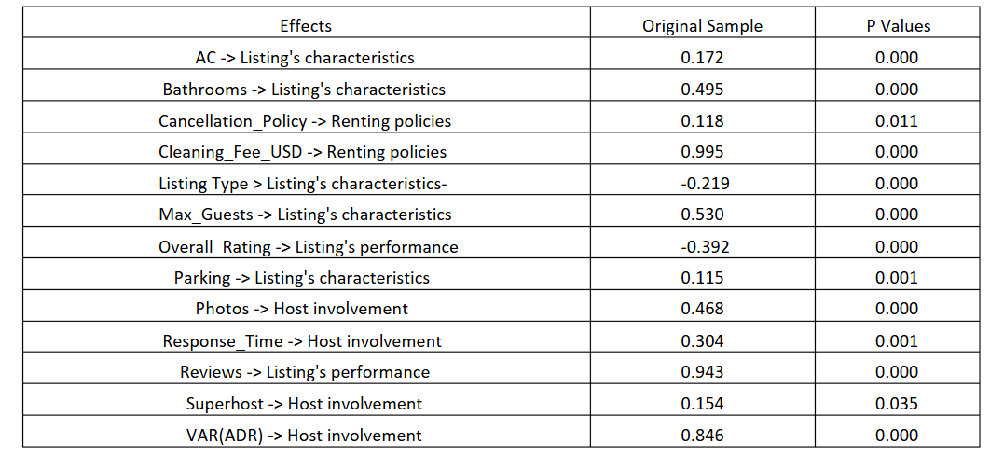
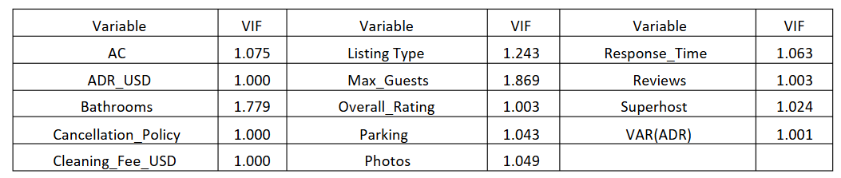
Related research
Pricing Strategies of Porto’s Airbnb New Listings
This study highlights, on the one hand, a great need for Airbnb to encourage dynamic pricing for its new hosts and, on the other hand, the challenges these hosts face when setting prices. An important feature of this paper is that it provides a series of theoretical and methodological implications for the pricing strategies of new Airbnb hosts. Furthermore, the paper highlights the idea that pricing strategies vary by city and country, highlighting the strategies of new Airbnb hosts.
The study builds on the hedonic pricing model and uses data on new Airbnb listings in Porto, focusing on the period when the COVID-19 pandemic changed tourism dynamics. The model analyzes the relationship between Airbnb pricing and various factors, such as:
Accommodation characteristics: size, type (e.g., private room, entire home), amenities (e.g., air conditioning, parking), and number of guests.
Location: proximity to the city center and neighborhood presence.
Host characteristics: experience (new vs. experienced host), engagement (Superhost status, response time, etc.), and behavior.
Rental policies: cancellation policy, cleaning fees, and booking flexibility.

Slide 25
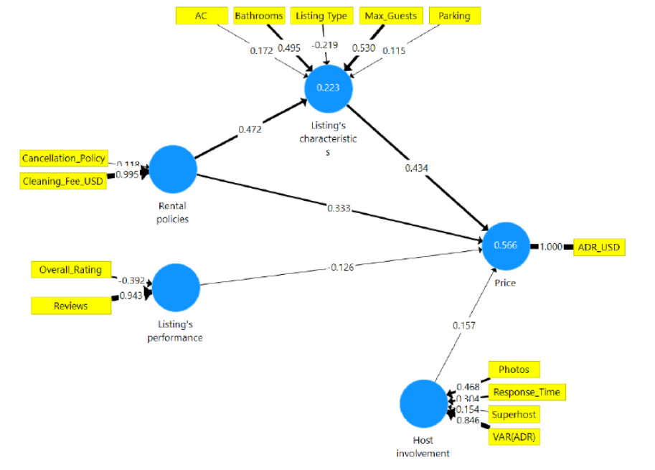
Related research
Pricing Strategies of Porto’s Airbnb New Listings
Key Findings
The Impact of Property Characteristics:
Property Size: Larger properties (more bedrooms and bathrooms) tend to command higher prices.
Amenities: Listings that offer amenities such as air conditioning, parking, or other amenities command higher prices, reflecting the heightened expectations of guests during the pandemic.
Location:
Proximity to a city center increases prices, as guests are willing to pay more for a central location due to convenience and safety concerns raised by the pandemic.
Host Behavior:
Super host Status: Listings managed by Super hosts typically command higher prices. Super hosts are trustworthy and have established reputations, which have become even more important during the pandemic.
Response Time and Engagement: Hosts respond faster to inquiries and engage more actively with guests, allowing them to charge higher prices due to their reliability and trustworthiness.
The Impact of Rental Policies:
Flexible rental policies, such as free cancellation or instant booking options, also have a positive impact on pricing. However, these policies have become less important during the pandemic as guests are more focused on health and safety.
Impact of the pandemic:
Safety concerns: During the pandemic, safety became a major factor in guest decision-making, overshadowing some traditional considerations such as location or amenities. As a result, properties that offer cleanliness and safety guarantees command higher prices.
Performance indicators:
Listings with higher occupancy rates, more reviews, and better ratings are associated with higher prices, demonstrating the importance of reputation in influencing price decisions.

Slide 26
References
Deboosere, R., Kerrigan, D., Wachsmuth, D., & El-Geneidy, A. (2019). Location, location and professionalization: a multilevel hedonic analysis of Airbnb listing prices and revenue. Regional Studies, Regional Science, 6, 143 - 156. https://doi.org/10.1080/21681376.2019.1592699.
Di Persio, L., & Lalmi, E. (2024). Maximizing Profitability and Occupancy: An Optimal Pricing Strategy for Airbnb Hosts Using Regression Techniques and Natural Language Processing. Journal of Risk and Financial Management. https://doi.org/10.3390/jrfm17090414.
Bode, O., Toader, V., & Rus, R. (2022). Pricing Strategies of Porto’s Airbnb New Listings. International Conference on Tourism Research. https://doi.org/10.34190/ictr.15.1.249.
DC Policy Center. (n.d.). The knowns and unknowns of Airbnb in D.C. DC Policy Center. Retrieved from https://www.dcpolicycenter.org/publications/the-knowns-and-unknowns-of-airbnb-in-d-c/
FourWeekMBA. (n.d.). Airbnb business model. FourWeekMBA. Retrieved from https://fourweekmba.com/Airbnb

